Slide 1



INSTITUTE: UIE (AIT-CSE)
CSS21: B.E. CSE (H) with specialization in Artificial Intelligence & Machine Learning
Advanced Machine Learning (20CSF-349)
Chapter 1.2: Logistic Regression
Lecture 9 & 10: Multivariate Logistic Regression & Confusion Matrix and Accuracy
By: Mr. Siddharth Kumar
DISCOVER . LEARN . EMPOWER

Slide 2
Advanced Machine Learning
Course Outcome
CO | Title
1 | Have a good understanding of the fundamental issues and challenges of machine learning: data, model selection, model complexity, etc.
2 | Appreciate the underlying mathematical relationships within and across Machine Learning algorithms and the paradigms of supervised and un-supervised learning
3 | Design and implement various machine learning algorithms in a range of real-world applications.
4 | Design and evaluate intelligent expert models for perception and prediction using machine learning algorithms
5 | Analyze and make use of machine learning algorithms-based applications using performance

Slide 3

What is Multivariate Logistic Regression?
As in univariate logistic regression, let π(x) represent the probability of an event that depends on p covariates or independent variables. Then, using an inv.logit formulation for modeling the probability, we have:
So, the form is identical to univariate logistic regression, but now with more than one covariate.
Note: by “univariate” logistic regression, I mean logistic regression with one independent variable; really there are two variables involved, the independent variable and the dichotomous outcome, so it could also be termed bivariate.
To understand the working of multivariate logistic regression, we’ll consider a problem statement from an online education platform where we’ll look at factors that help us select the most promising leads, i.e. the leads that are most likely to convert into paying customers.

Slide 4
Multivariate logistic regression is used to predict categorical placement in or the probability of category membership on a dependent variable based on multiple independent variables. The independent variables can be either dichotomous (i.e., binary) or continuous (i.e., interval or ratio in scale). Multinomial logistic regression is a simple extension of binary logistic regression that allows for more than two categories of the dependent or outcome variable. Like binary logistic regression, multinomial logistic regression uses maximum likelihood estimation to evaluate the probability of categorical membership.
Variable selection or model specification methods for multivariate logistic regression are similar to those used with standard multiple regression; for example, sequential or nested logistic regression analysis. These methods are used when one dependent variable is used as criteria for placement or choice on subsequent dependent variables (i.e., a decision or flow-chart). For example, many studies indicate the decision to use drugs follows a sequential pattern, with alcohol at an initial stage followed by the use of marijuana, cocaine, and other illicit drugs.

Slide 5
Confusion Matrix and Accuracy
We define classification accuracy as the ratio of correct predictions to total predictions.
One of the major issues with this approach is that it often hides the very detail that you might require to better understand the performance of your model.
A very likely example where you can encounter this problem is when you’re working with a data having more than 2 classes. You may achieve an accuracy rate of, say 85%, but you’ll not know if this is because some classes are being neglected by your model or whether all of them are being predicted equally well.
It is a summary of prediction results on a classification model.
In two-class problems, we construct a confusion matrix by assigning the event row as “positive” and the no-event row as “negative”. The event column of predictions is assigned as “true” and the no-event one as “false”.

Slide 6


The matrix would then consist of the following elements:
(i) True positive — for correctly predicted event values
(ii) True negative — for correctly predicted no-event values
(iii) False positive — for incorrectly predicted event values
(iv) False negative — for incorrectly predicted no-event values
Some basic performance measures derived from the confusion matrix are:
Some basic performance measures derived from the confusion matrix are:
(a) Sensitivity or Recall: Sensitivity (SN) is calculated as the number of correct positive predictions divided by the total number of positives. It is also called recall (REC) or true positive rate (TPR). Mathematically,

Slide 7


(b) Specificity: Specificity (SP) is calculated as the number of correct negative predictions divided by the total number of negatives. It is also called true negative rate (TNR). Mathematically,
(c) Precision: Precision (PREC) is calculated as the number of correct positive predictions divided by the total number of positive predictions. It is also called positive predictive value (PPV). Mathematically,
We’ll use the above matrix and the metrics to evaluate the model. 0.5 was a randomly selected value to test the model performance. We need to optimize the threshold to get better results, which we’ll do by plotting and analyzing the ROC curve.

Slide 8
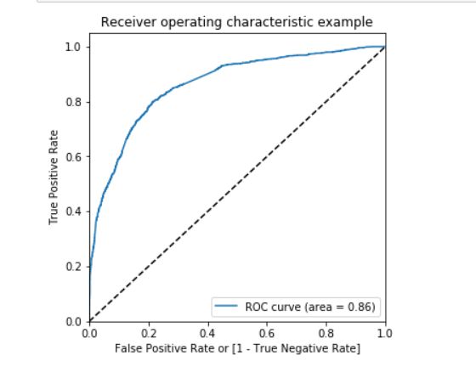
The Receiver Operating Characteristic curve is basically a plot between false positive rate and true positive rate for a number of threshold values lying between 0 and 1.
The ROC curve helps us compare curves of different models with different thresholds whereas the AUC (area under the curve) gives us a summary of the model skill.
Here, the AUC is 0.86 which seems quite good. To find the optimal cut-off point, let’s also check for sensitivity and specificity of the model at different probability cut-offs and plot the same.

Slide 9
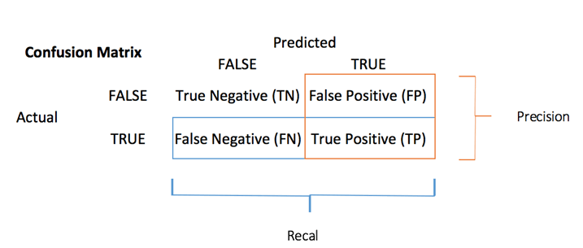

The confusion matrix visualizes the accuracy of a classifier by comparing the actual and predicted classes. The binary confusion matrix is composed of squares:
You can compute the accuracy test from the confusion matrix:

Slide 10
References
T1: Mitchell T.M., Machine Learning, McGraw Hill (1997).
T2: Andreas C. Miller, Sarah Guido, Introduction to Machine Learning with Python, O’REILLY (2001).
Notes:
Introduction to Cyber Security (simplilearn.com)

Slide 11

THANK YOU

